Slide 2
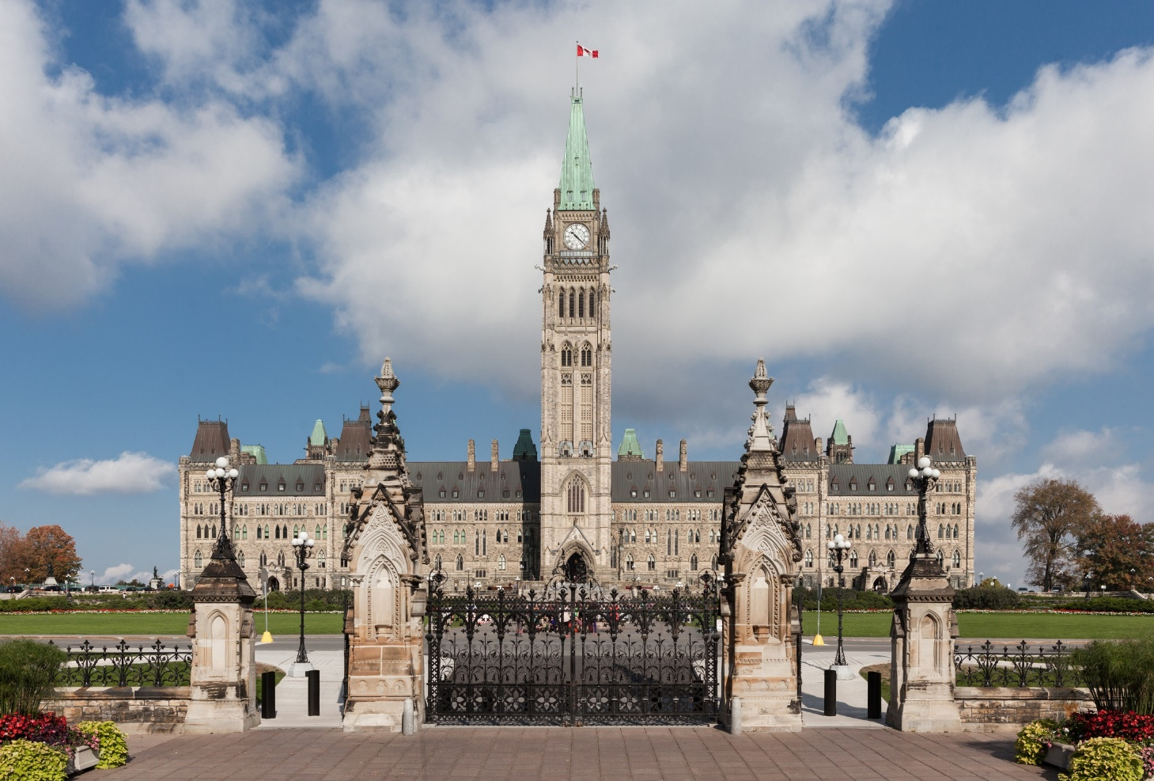
Centre Block
What makes this building an important place?
You may want to think about…
Why was Centre Block built?
What kind of work happens in this building?
Who works here?
What does the building symbolize to people?
© Library of Parliament | Jonathan Harrington

Slide 3
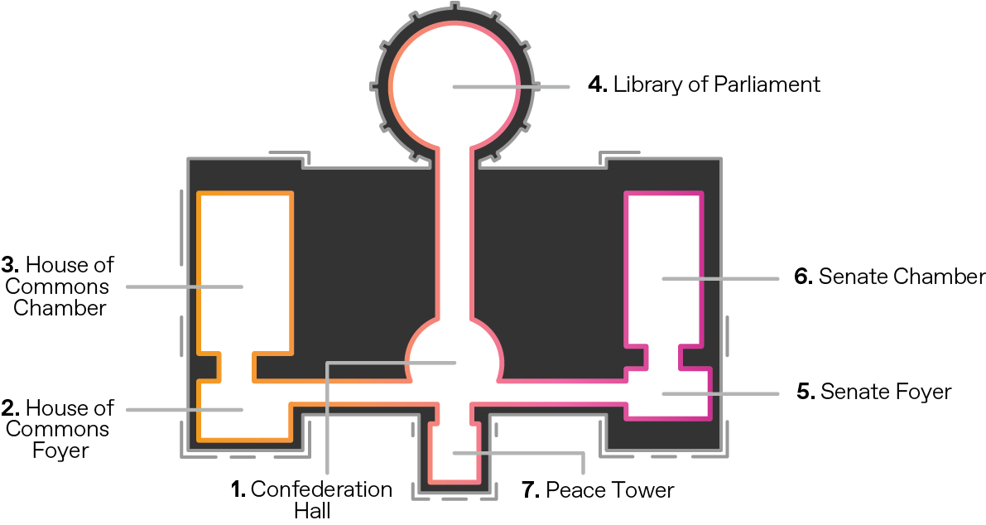
Parliament in 360°
These are the places you will visit in Centre Block.

Slide 4
Start your 360° video experience!
Option 1: Individual viewing | Option 2: Class viewing | Option 3: Mobile VR headset viewing
Open the link on your device: https://bit.ly/2Ei7lce Plug in your headphones (if available) Make the video full screen If you are on a tablet or phone, move the device or drag the image to look around the spaces If you are on a computer, click and drag to look around the spaces | Open the link (https://bit.ly/2Ei7lce) on your device and make the video full screen Make sure your speakers are on Click and drag to look around the spaces | Open the link on your smartphone: https://bit.ly/2Ei7lce Make the video full screen Press the button in the corner Place the phone inside the headset Plug in your headphones (if available) Hold the headset to your eyes like binoculars. Move your head to look around the spaces.

Slide 5
What did you experience in the different rooms of Centre Block?
Space | See | Hear | Learn
Confederation Hall
House of Commons Foyer
House of Commons
Library of Parliament
Senate Foyer
Senate
Peace Tower

