Slide 2
Get ready for VR!
How many details can you remember about these photos?

Slide 3
Peace Tower
© Library of Parliament | Roy Grogan

Slide 4
Peace Tower
What did you notice about the picture?
What time is the clock showing?
What colour is the roof?
What patterns or carvings did you see on the tower?

Slide 5
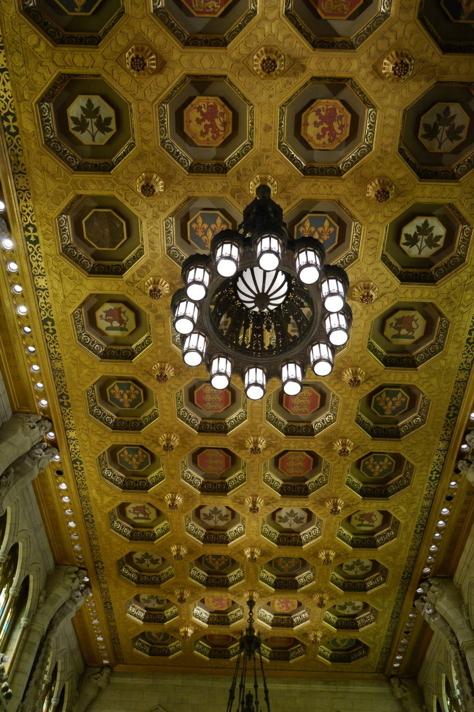
Senate
© Library of Parliament

Slide 6
Senate
What did you notice about the picture?
How many different symbols are on the ceiling?
What animals and plants do they show?
How many lights make up the chandelier?

Slide 7
House of Commons
© Library of Parliament | Roy Grogan

Slide 8
House of Commons
What did you notice about the picture?
How many stained-glass windows are there?
What images and symbols did you see in the windows?
What colour is the centre of the flowers?

Slide 9
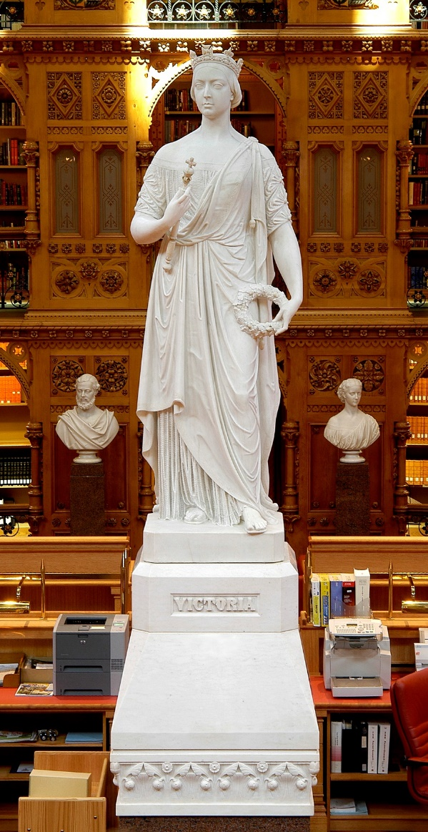
Library of Parliament
© Library of Parliament | Mone Cheng

Slide 10
Library of Parliament
What did you notice about the picture?
What is the person in the statue holding?
What name appears on the statue base?
What could you see behind the statue?

Slide 11
What can you hear around you?
Close your eyes and listen carefully. What sounds can you hear from the school or outside?

Slide 12
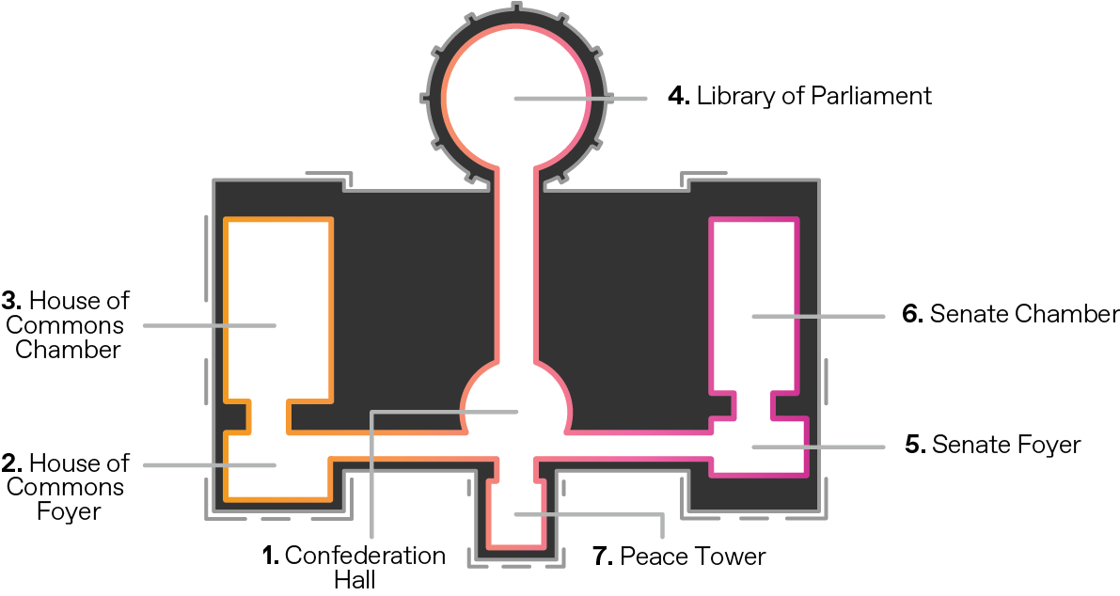
Parliament in virtual reality
These are the places you will visit in Centre Block.

Slide 13
VR health and safety
Please review the VR headset healthy and safety guidelines before you start.

Slide 14
VR health and safety
Please remember to:
1. Always wear the hygiene mask.
2. Avoid touching the headset lenses.
3. Put the controller string around your wrist.
4. Put on and take off the headset with both hands.
5. Stay seated throughout the experience.
6. Avoid reaching out or making contact with other students while wearing a headset.

Slide 15
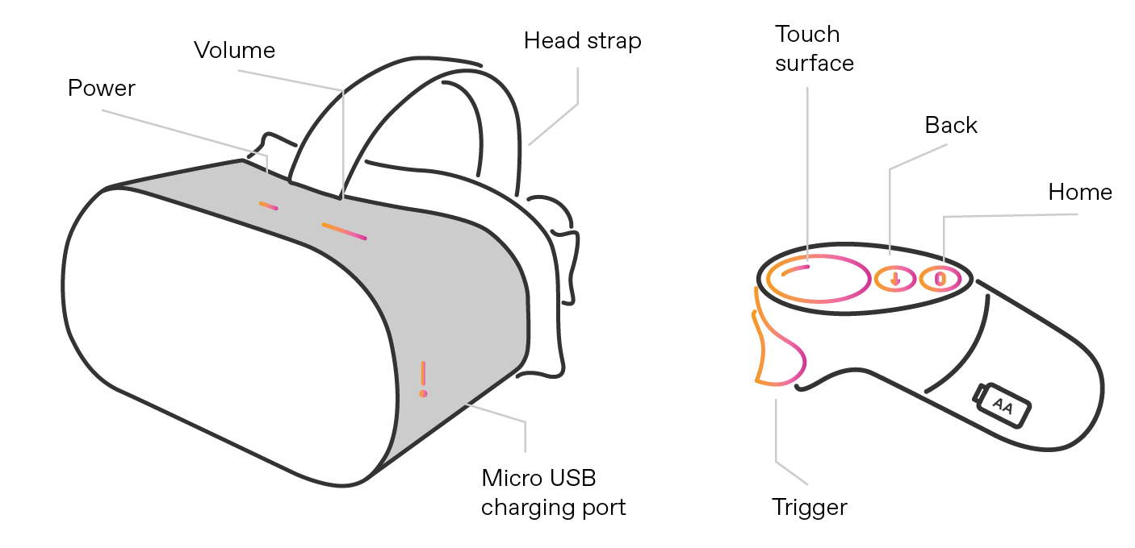
How to set up your headset
Hold down the power button to turn on the headset.
Put on the hygiene mask. If you wear glasses, remove them, put on the hygiene mask, then put your glasses back on.
Put on the headset. Adjust the Velcro straps at the top and sides if it feels uncomfortable.
Use the controller trigger to select “Library” from the menu bar.
Select the Parliament – Parlement application.
Place the controller back on the desk.

Slide 16
How to shut down your headset
Hold down the power button.
Use the controller trigger to select “Power Off” from the shutdown menu.

