Slide 1


Slide 2

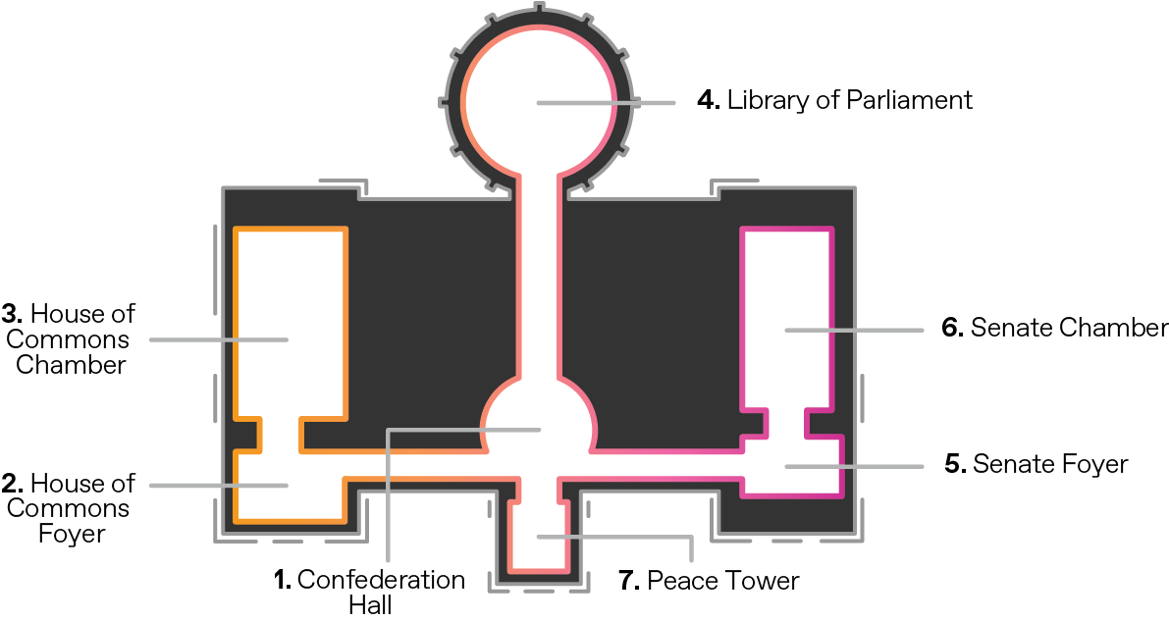
Who did you encounter in Centre Block?
Name the people you heard about during the virtual experience of Centre Block.

Slide 3
Who am I?
Here are some of the people you encountered in the virtual experience of Centre Block.
Monarch
Governor General
Prime Minister
Speaker of the Senate
Speaker of the House of Commons
Senator
Member of the House of Commons
Journalist

Slide 4
Who am I?
Based on the list on the previous slide, name the person that best fits
the description. Each person is only used once.

Slide 5
Who am I?
I am appointed by the Governor General on the advice of the Prime Minister. I facilitate debates and business in the Upper Chamber.
#1

Slide 6
Who am I?
I ask parliamentarians tough questions and report on the work of Parliament to Canadians. My job is to hold Parliament and parliamentarians accountable.
#2

Slide 7
Who am I?
I represent the Monarch in Canada. I give Royal Assent to bills after they are passed by the Senate and the House of Commons.
I call elections and open Parliament.
#3

Slide 8
Who am I?
I am appointed by the Governor General on the advice of the Prime Minister to represent a region of the country. Besides proposing and passing bills, I meet regularly with Canadians to hear their views on bills and national issues.
#4

Slide 9
Who am I?
I am (usually) the leader of the party with the most seats in the House of Commons. My party helps set the agenda for the issues and bills discussed at Parliament.
#5

Slide 10
Who am I?
I am elected by Canadians to represent a constituency (or riding).
I propose, debate and vote on bills.
#6

Slide 11
Who am I?
I am elected by my colleagues in the Lower Chamber to make sure that rules and procedure are followed. During debates, all questions are directed to me.
#7

Slide 12
Who am I?
I am Canada’s head of state. I am also the head of state of 15 other countries.
#8

Slide 13
Parliamentarians who made an impact
Choose a parliamentary figure to learn more about. You may want to choose someone who was…
A trailblazer: Who was the first female, francophone, Indigenous person, or member of
a minority community to take on a certain role at Parliament?
Dedicated to an issue: Think of an issue or cause that interests you. Find a parliamentarian who tackled that issue or championed that cause.
Involved in a historic event: Select a time period or historic event and find a parliamentary figure who was involved.

Slide 14
Parliamentarians who made an impact
Research your chosen person in more detail. There are lots of sources out there, but here are a few to get you started:
Parlinfo – lop.parl.ca/parlinfo
Canadian Encyclopedia – thecanadianencyclopedia.ca
Dictionary of Canadian Biography – www.biographi.ca
Centre Block: Moments in Time – youtu.be/KhAQ1WLBmQo

